Slide 1


Mobile App and Source Code Management
Day IV

Slide 2
Mobile App Overview and Demonstration
Session - 1
Learning Objectives:
  Understand the structure and workflow of the React Native (Expo) mobile application integrated with the DLC backend.
  Demonstrate key mobile features including user registration, content browsing, downloading, search, profile management, and favorites.
  Configure and customize branding elements such as logo, color theme, and app name.
  Set up and test API connections between the app and the Laravel backend.

Slide 3
Understanding React Native and Expo
What is React Native?
  React Native is a cross-platform framework developed by Meta (Facebook) for building mobile applications using JavaScript and React.
  It allows you to build native-quality Android and iOS apps from a single codebase.
  React Native uses native components instead of web components, ensuring a smoother and faster mobile experience.
  Key Benefits:
    Code once, deploy on both Android and iOS.
    Reusable components with consistent UI.
    Easy integration with APIs and backends (like Laravel).
    Large developer community and open-source support.

Slide 4
What is Expo?
  Expo is a development platform and toolkit built around React Native that simplifies app creation, testing, and deployment.
  It provides prebuilt APIs and utilities that eliminate complex native setup.
  Key Features:
    No Android Studio or Xcode needed to start.
    Expo Go App allows you to preview the app instantly on your mobile.
    Simplified building and signing of APK/IPA files.
    Easy access to device features (camera, file system, notifications, etc.).
  How Expo Integrates with the DLC App
    The frontend (React Native) fetches content through Laravel API endpoints.
    Changes in backend data (like new videos or users) are reflected automatically in the mobile app through API synchronization.
    The app’s structure, styling, and branding are managed in Expo’s development environment.

Slide 5
Demonstration of Major Features
This segment highlights how backend data flows into the app for end users.
Features Demonstrated:
  User Registration – Create a new user account and verify access.
  Exploring Learning Resources – View videos and categories.
  Download Functionality – Download a video for offline viewing.
  Search – Find content by keyword or category.
  Profile Management – Update user info or change password.
  Favorite Learning Resources – Add or remove favorite videos.

Slide 6
Exercise 1:
Log in or register as a new user.
Search for a topic and play a video.
Download one video and confirm it plays offline.
Add one resource to Favorites and verify it appears in the Favorites tab.

Slide 7
Understanding React Native Expo App Structure
Every mobile app has a specific file and folder structure that defines its behavior, interface, and navigation.
  Understanding this structure helps administrators and developers locate files quickly when they need to edit or troubleshoot.
  Folder structure overview:
    /assets → a dedicated location for storing static resources
    App.js → main entry point of the application.
    /navigation → defines tab and stack navigation.
    /screens → individual pages (Home, Login, Profile, etc.).
    /components → reusable elements like buttons, cards.
    /config → holds API configurations.

Slide 8
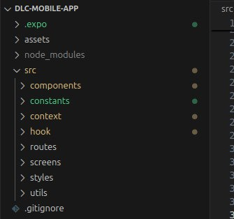

Slide 9
Exercise 2:
Open the project in VS Code.
Explore and label each folder in your notes.

Slide 10
Environmental Setup and Managing Mobile App Code
Session - 2
Learning Objectives:
  Set up a working React Native + Expo development environment on their computer.
  Understand and configure project settings (API links, dependencies, and environment files).
  Run and test the mobile app both on an emulator and a physical mobile device.
  Update text or interface content and observe changes in real-time.
  Create an Expo account, build, and sign an APK for Android deployment

Slide 11
Environment Setup
Before editing or deploying the mobile app, participants need a functional development environment. This section focuses on installing and configuring all essential tools for React Native with Expo.
Tools Required
  Install Node.js
    Verify installation using:
    node -v npm -v
  Install Expo CLI
    npm install -g expo-cli
  Verify Expo Installation
    expo --version
  Open Project in VS Code
    Navigate to project folder.
    Ensure all dependencies are installed with:
    npm install

Slide 12
Exercise 1:
Verify your Node.js and Expo versions.
Open the DLC project folder and run npm install successfully.

Slide 13
Installing Expo Go on Mobile & Running the App
The Expo Go app enables developers and testers to view live updates of their project without building a full APK. It’s perfect for quick testing and demonstrations.
  Download Expo Go from the Play Store.
  Start the development server
    npx expo start
  Scan the QR code displayed in the terminal after running expo start.
  Wait for the project to load on the phone.
  Test interactivity (login, navigation).

Slide 14
Exercise 2:
Run the app successfully on android or ios mobile device
Observe the Expo logs to confirm successful API connection.

Slide 15
Update Mobile UI and Rerun
Developers frequently need to update small pieces of content such as titles, labels, or colors. This section helps participants safely make and test such changes.
  Open a simple screen, e.g., src/componets/home/weclome/Welcome.jsx
  Add new text such as:
      <Text> Welcome to the training</Text>
  Save the file and watch Expo Hot Reload refresh automatically.

Slide 16
Exercise 3:
Modify the welcome text and observe changes live.
Change a text color and rerun the app.

Slide 17
Creating Expo Account
Having an Expo account is essential for building signed APKs and publishing projects.
  Go to https://expo.dev/signup.
  Create an account using email or GitHub.
  Login via CLI:
  expo login
  Verify credentials are stored.

Slide 18
Exercise 4:
Each participant creates an Expo account and logs in successfully from their terminal.

Slide 19
Building and Signing the APK
Once your app runs correctly, the next step is building a production-ready APK that can be distributed or tested on other devices.
  Run the build command:
    eas build -p android --profile preview
    (or expo build:android if using the classic build)
  Wait for the build process to finish.
  Download the APK link from the Expo build dashboard.
    Explain debug vs release builds.
    Introduce keystore signing and how to securely store it.

Slide 20
Exercise 5:
Run the build command on your local machine or follow along as the instructor demonstrates.
Download and install the APK on your phone for testing.

Slide 21
Best Practice Tips
Keep Node.js and Expo CLI updated regularly.
Avoid hardcoding credentials or URLs in your code.
Always test API connectivity before building APKs.
Document all configuration changes.
Use version control (Git) to track your edits and commits.

Slide 22
Source Code Management
Session - 3
Learning Objectives:
  Explain the concept and importance of version control.
  Initialize and manage a Git repository for the DLC system.
  Track, commit, and revert changes using Git commands.
  Configure and use a .gitignore file to exclude unnecessary files from version tracking.

Slide 23
Introduction to Version Control
Version Control Systems (VCS) is a tool, used in software development and collaborative projects, allow developers to keep track of every change, collaborate efficiently, and restore older versions of code when needed.
  It allows developers to:
    Record and track every update to the codebase
    Collaborate on code without overwriting each other's work
    Revert to earlier states of the project if needed
    Maintain a detailed and structured history of the project’s evolution
  Types of Version Control Systems
    Local version control systems
    Centralized version control systems
    Distributed version control systems

Slide 24
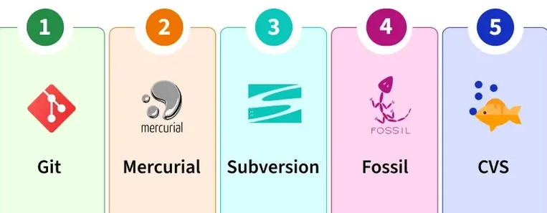
Popular Version Control Systems
  Below are five most widely used free VCS tools, perfect for individuals and teams.
  Each of these version control systems serves different needs, and the choice depends on the project size, team collaboration style and workflow preferences.

Slide 25
Git - Overview
Git is the most widely used Distributed Version Control System, developed by Linus Torvalds in 2005 for managing the Linux kernel.
  It is highly efficient, supports branching and merging, and has a fast, decentralized workflow.
  It is the backbone of services like GitHub, GitLab and Bitbucket, making it a popular choice for developers worldwide.
  Key Features of Git
    Lightweight, fast and efficient.
    Branching and merging are simple and non-destructive.
    Provides powerful commands like git clone, git pull and git push.

Slide 26
Installing and Configuring Git
Before using Git, we must ensure it’s properly installed and configured with the developer’s identity.
  Download the latest Git and Install
    https://git-scm.com/install/
  Check installation:
    git --version
  Configure user information:
    git config --global user.name "Your Name" git config --global user.email "you@example.com"
  Verify setup:
    git config --list

Slide 27
Setting Up a Git Repository
A Git repository tracks every change made to a project’s files.
We’ll initialize one for the DLC system and make the first commit.
  Navigate to the project folder:
    cd project-name
  Initialize Git:
    git init
  Add files to staging:
    git add .
  Commit with a message:
    git commit -m "Initial project setup"
  View history:
    git log --oneline

Slide 28
Exercise 1:
Initialize a Git repository in your project folder.
Add and commit the current project version.
Run git log and share your latest commit message.

Slide 29
Managing Changes and History
Git lets developers track changes and manage versions efficiently.
This helps detect bugs, test new features, or revert unwanted edits.
  Tracking changes (git status, git diff)
  Committing updates
  Viewing commit history
  Undoing unwanted edits (git checkout -- filename)

Slide 30
Exercise 2:
Modify a small file (e.g., README.md) and commit the update.
Use git diff to see what changed before committing.
Revert a file to a previous version and verify.

Slide 31
Managing .gitignore
Some files should never be tracked (e.g., environment variables, dependencies, build folders).
  .gitignore ensures such files are excluded automatically.
Managing .gitignore file:
  Create .gitignore file.
  Add entries like:
    node_modules/
    .expo/
    .env
    .vscode/
    build/
  Check with git status to confirm they are ignored.

Slide 32
Exercise 3:
Create a .gitignore file in your project.
Add at least three file/folder names to exclude.

Slide 33
Source Code Collaboration and Wrap-up
Session - 4
Learning Objectives:
  Explain the importance of collaborative version control.
  Create and configure a GitHub account.
  Connect local repositories to remote ones.
  Perform push, pull, and synchronization operations.
  Apply best practices and understand common challenges in team-based source code management.
  Reflect on the entire day’s learning outcomes.

Slide 34
Collaborative Development Overview
When teams work together on a project, GitHub (or GitLab/Bitbucket) acts as a central code-sharing platform.
It allows collaboration, review, and version tracking from anywhere.
Concepts to Cover:
  Local vs Remote repositories
  Branching and merging overview
  Benefits of using GitHub (backup, team collaboration, project visibility)

Slide 35
Local vs Remote Repositories
Type | Description | Example
Local Repository | Stored on your computer; where you do commits and history tracking. | Your folder: /dlc-mobile/
Remote Repository | Stored on a server (like GitHub) to enable collaboration. | GitHub, GitLab, Bitbucket
Sync Process | You push changes from local → remote, and pull updates from remote → local. | git push / git pull

Slide 36
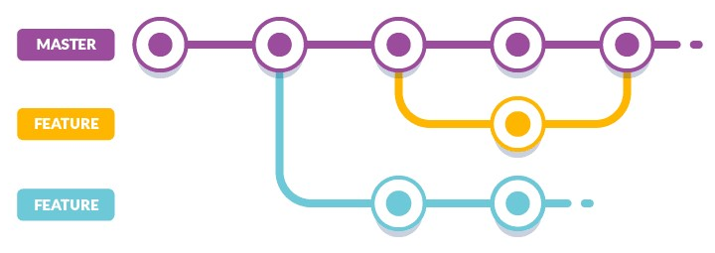
Branching and Merging Overview
Branching is one of the most powerful features in Git. It allows developers to create separate lines of development without affecting the main codebase.
  A branch represents an independent line of development.
  The main (or master) branch is the default.
  You can create new branches to:
    Develop new features
    Fix bugs
    Experiment safely
Once your work in a branch is complete, you can merge it back into the main branch.
  Merging combines changes from one branch into another.
  Common merge tools: Git CLI, VS Code, GitHub pull requests

Slide 37
Benefits of Using GitHub
What is GitHub?
  GitHub is a cloud-based platform that provides hosting for Git repositories and tools for collaborative software development.
Key Benefits of Using GitHub
  Collaboration: Multiple users can work on the same project easily.
  Backup and Accessibility: Code is securely stored in the cloud.
  Integration: Works with tools like VS Code, Slack, and CI/CD pipelines.
  Transparency: Tracks changes, authors, and project history.
  Open Source Community: Contribute and learn from millions of projects.

Slide 38
Creating a GitHub Account
Each participant will create a personal GitHub account to store and share project code.
  Steps:
    Visit https://github.com
    Sign up and verify email.
    Configure profile and create a new repository named dlc-mobile.
    Copy repository URL for connection.

Slide 39
Exercise 1:
Create your GitHub account and repository named after your project.

Slide 40
Pushing and Pulling Projects
Once a remote repository is ready, you can link it to your local Git project to push and pull changes.
  Steps:
    Link to GitHub:
      git remote add origin https://github.com/username/dlc-mobile.git
    Push local changes:
      git push -u origin main
    Pull updates:
      git pull
    Common commands:
      git fetch – retrieve updates without merging
      git merge – integrate fetched changes

Slide 41
Exercise 2:
Connect your local Git repository to your GitHub repository.
Push your latest project version.
Pull the project from GitHub into a new folder to confirm success.

Slide 42
Best Practices, Common Challenges, and Solutions
Using Git effectively requires consistent habits and awareness of common pitfalls.
  Best Practices:
    Commit small, meaningful changes.
    Always pull before push.
    Use clear commit messages.
    Keep .env files and secrets local.
    Regularly back up and sync work.

Slide 43
  Common Challenges and Solutions:
Challenge | Solution
Merge conflicts | Communicate and use git merge carefully
Lost commits | Use git reflog to recover
Wrong file committed | Use .gitignore properly
Authentication issues | Use SSH or Personal Access Tokens

Slide 44
Q&A and Reflection
A reflection session helps participants consolidate what they learned and plan how to apply Git and GitHub in real projects.
Reflection Prompts:
  What did you find most useful about Git and GitHub?
  What challenges did you face?
  How will you integrate version control into your future workflow?

Slide 45


